Slide 1

CU-Event Management System
Second Progress Report
Project Members :
Harshit Srivastava, 19BCS1142, CSE 2A
Tanmay Tripathi, 19BCS1120, CSE 1C

Slide 2
Technology used
FrontEnd :
HTML : It describes the structure of a Web page.
CSS : It describes how HTML elements are to be displayed on screen.
JS : It adds interactivity to website.
Bootstrap : It is the most popular HTML, CSS, and JavaScript framework for developing responsive websites.

Slide 3
Technology used
Backend :
Nodejs : It is a JavaScript runtime environment that executes JavaScript code outside a web browser. It can create, open, read, write, delete, and close files on the server.
Nodemon : It is a tool that helps develop node. js based applications by automatically restarting the node application when file changes occurs in the directory
Express : It is a minimal and flexible Node.js web application framework that allows to dynamically render HTML Pages based on passing arguments to templates.
Mongoose : It manages relationships between data, provides schema validation, and is used to translate between objects in code and the representation of those objects in MongoDB.
MongoDB : It is a schema-less NoSQL document database.

Slide 4
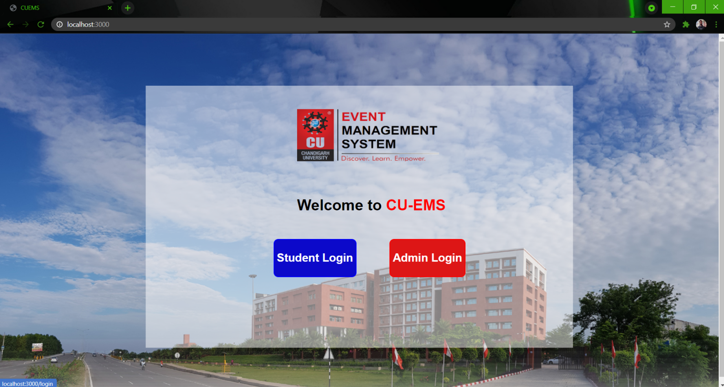
Implementation
Landing page :

Slide 5
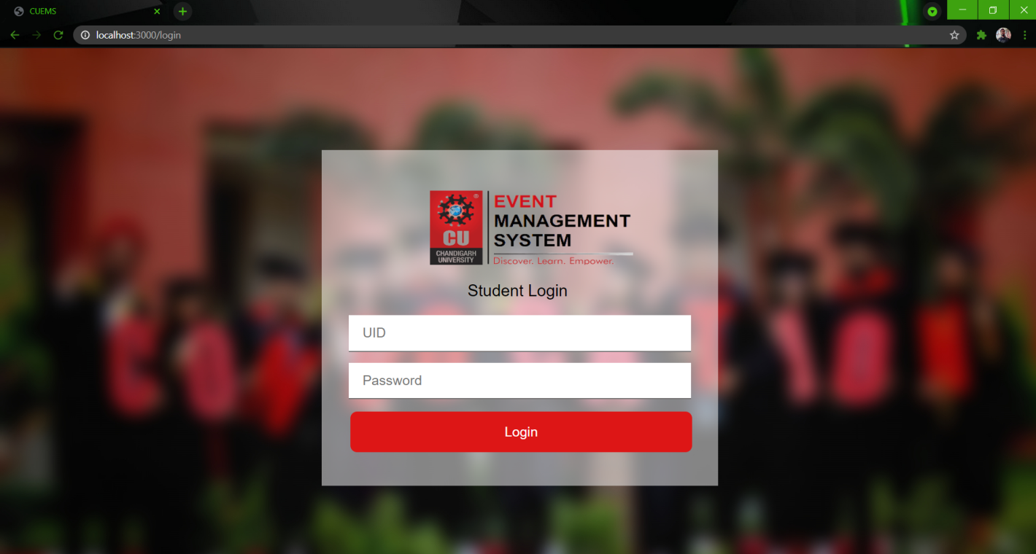
Implementation
Student Login page :

Slide 6
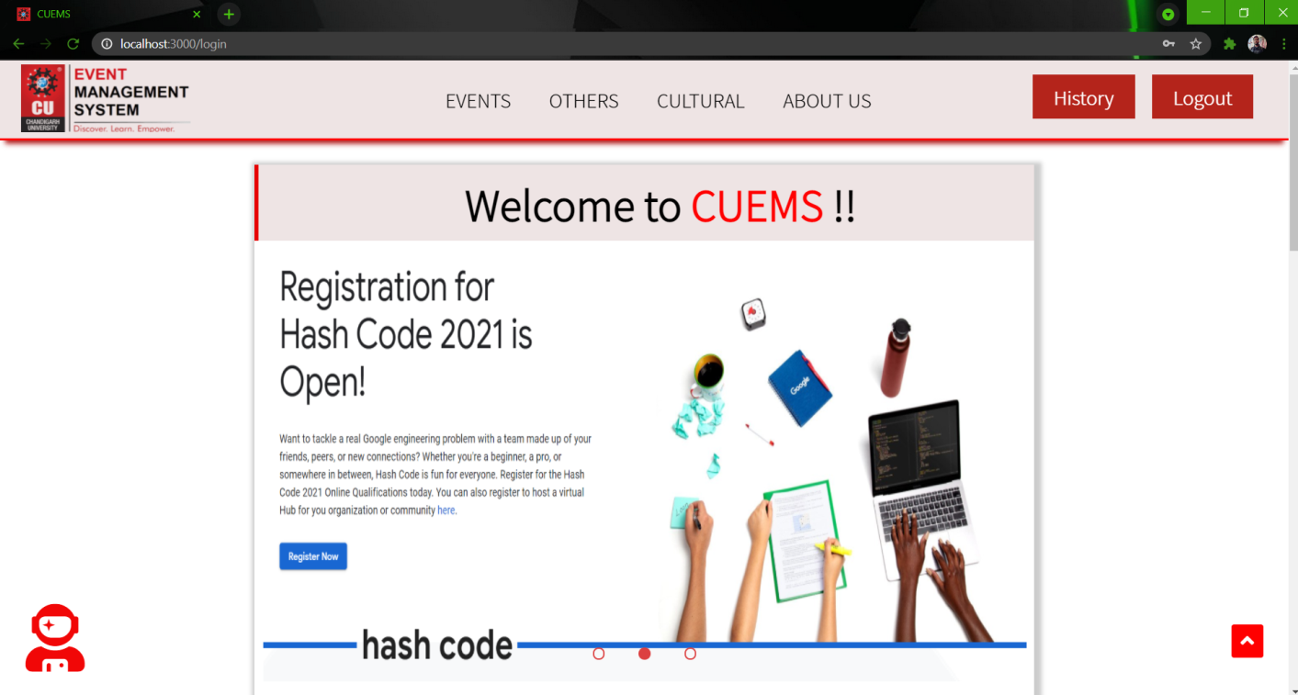
Implementation
Student Home page :

Slide 7
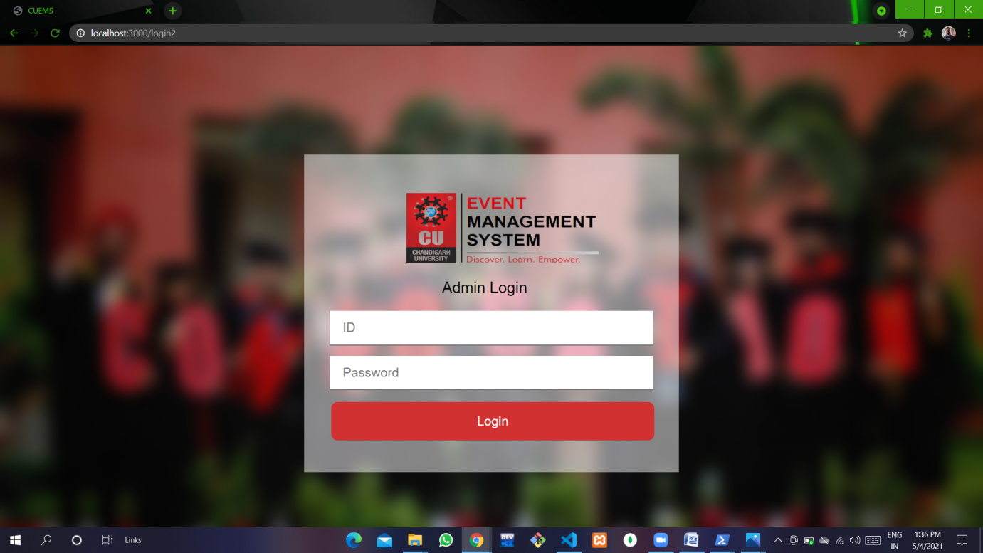
Implementation
Admin Login Page :

Slide 8
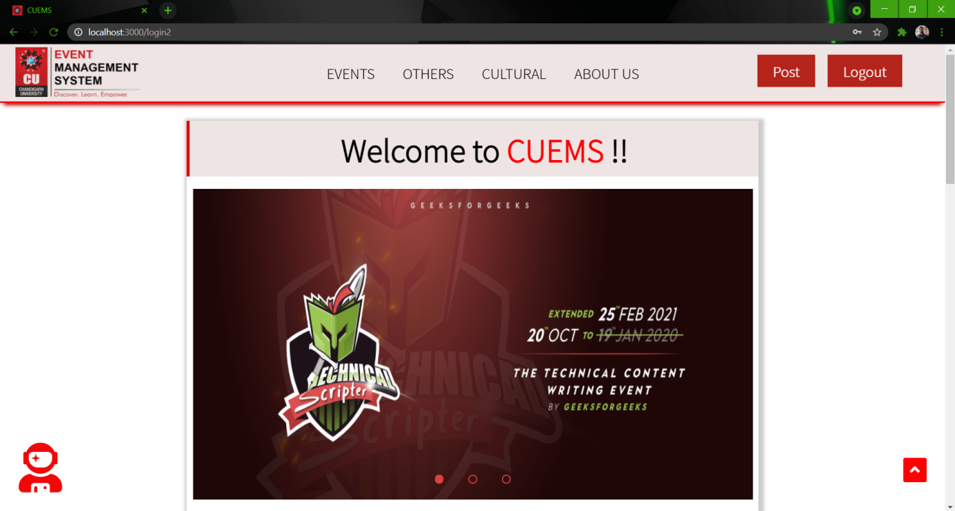
Implementation
Admin Home Page :

Slide 9
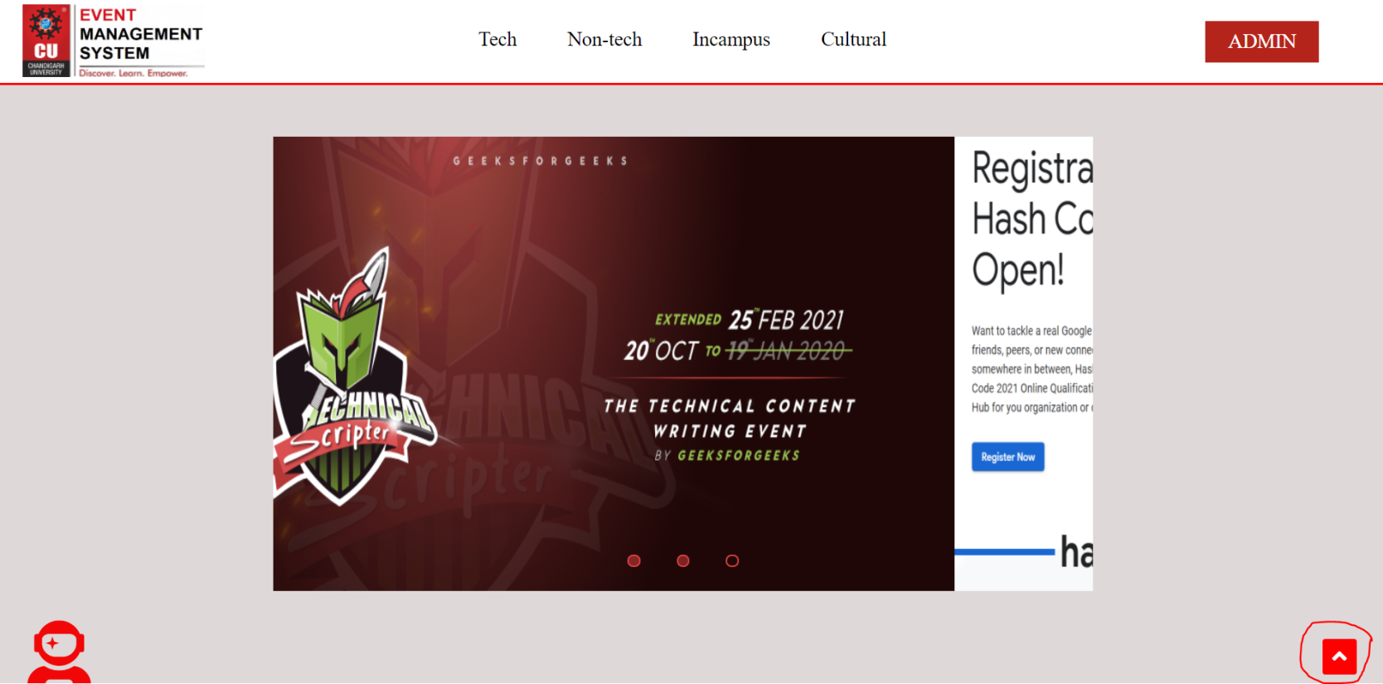
Implementation
Arrow Button :
This arrow button functionality is to move to top of the page when the user scroll down the web page.

Slide 10
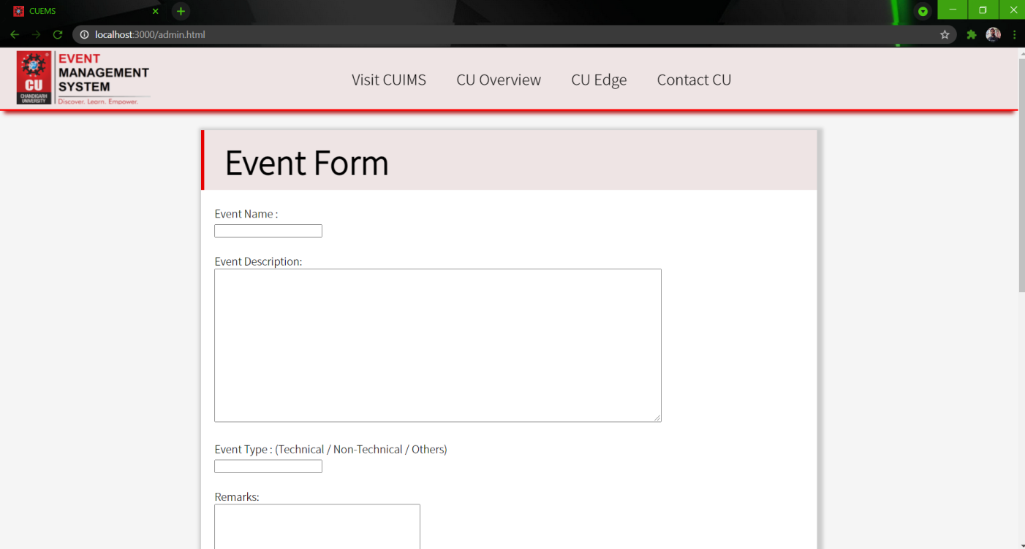
Implementation
Admin Event Form Page :

Slide 11
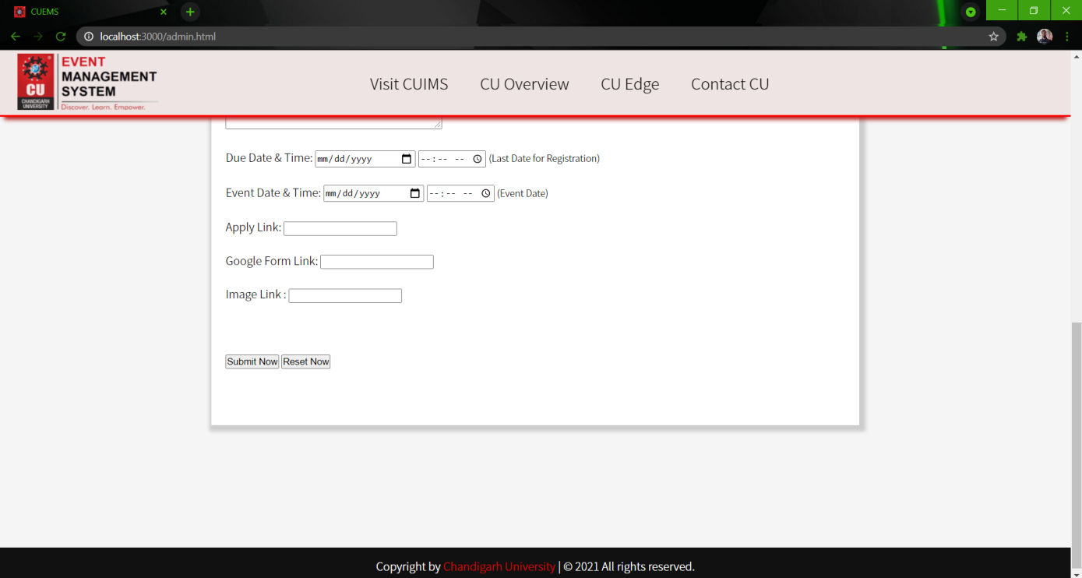
Implementation
Admin Event Form Page :

Slide 12
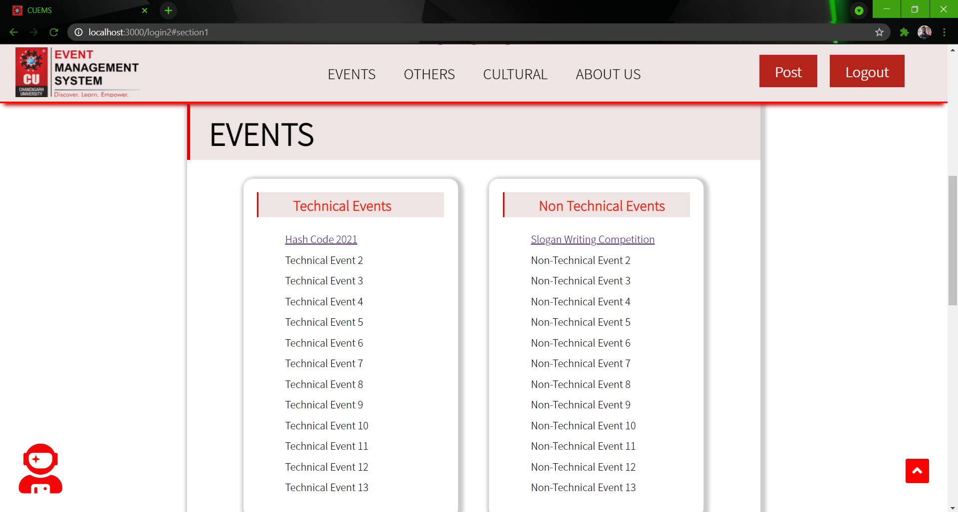
Implementation
EVENTS :

Slide 13
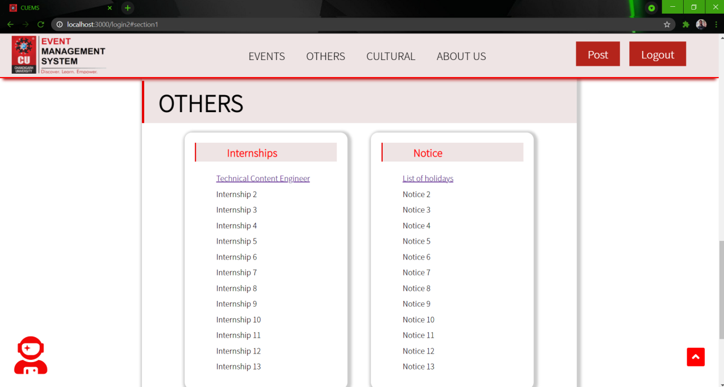
Implementation
OTHERS :

Slide 14
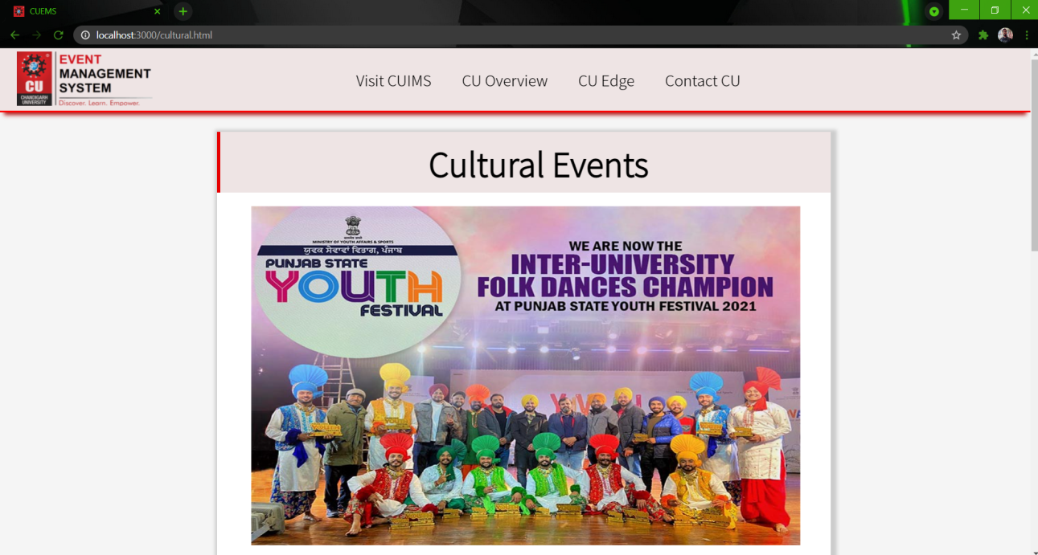
Implementation
CULTURAL :

Slide 15
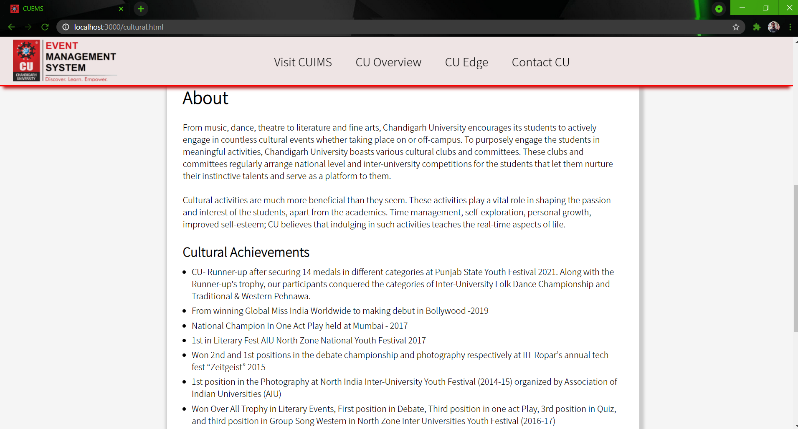
Implementation
CULTURAL :

Slide 16
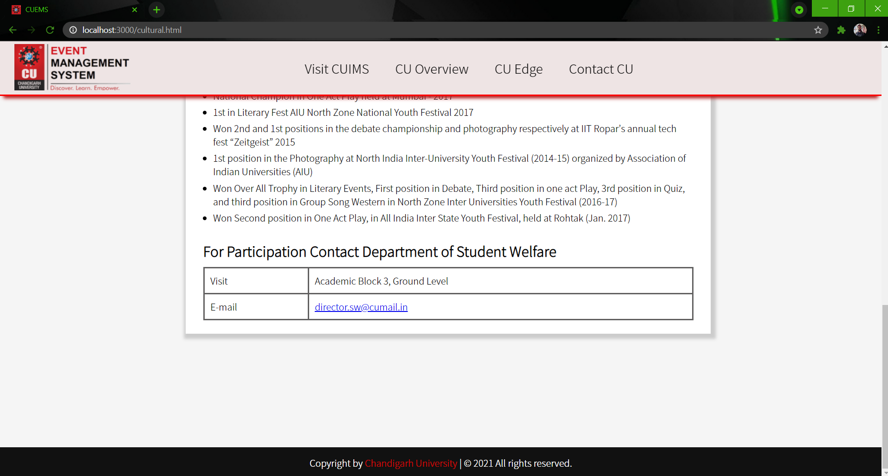
Implementation
CULTURAL :

Slide 17
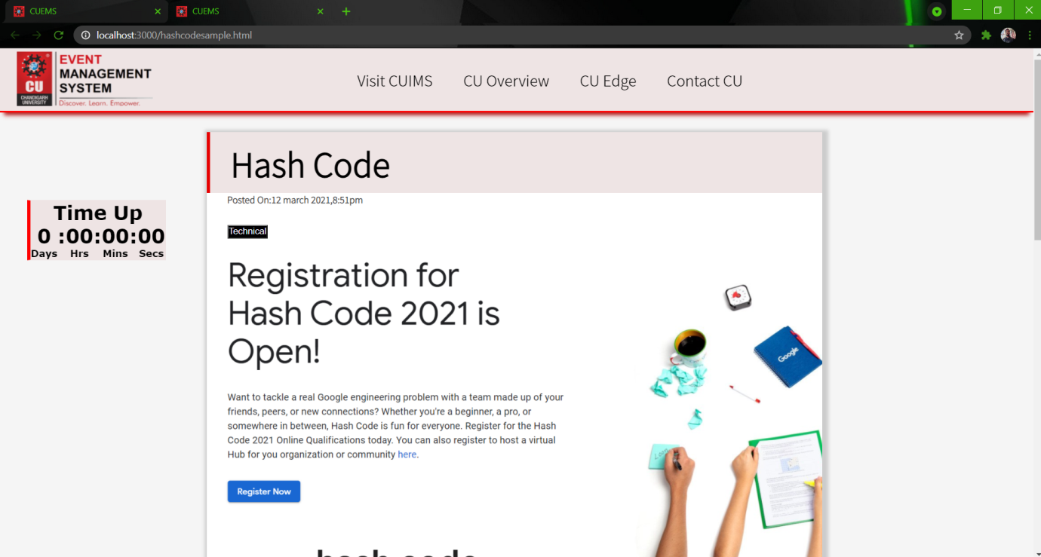
Implementation
Sample Event page :

Slide 18
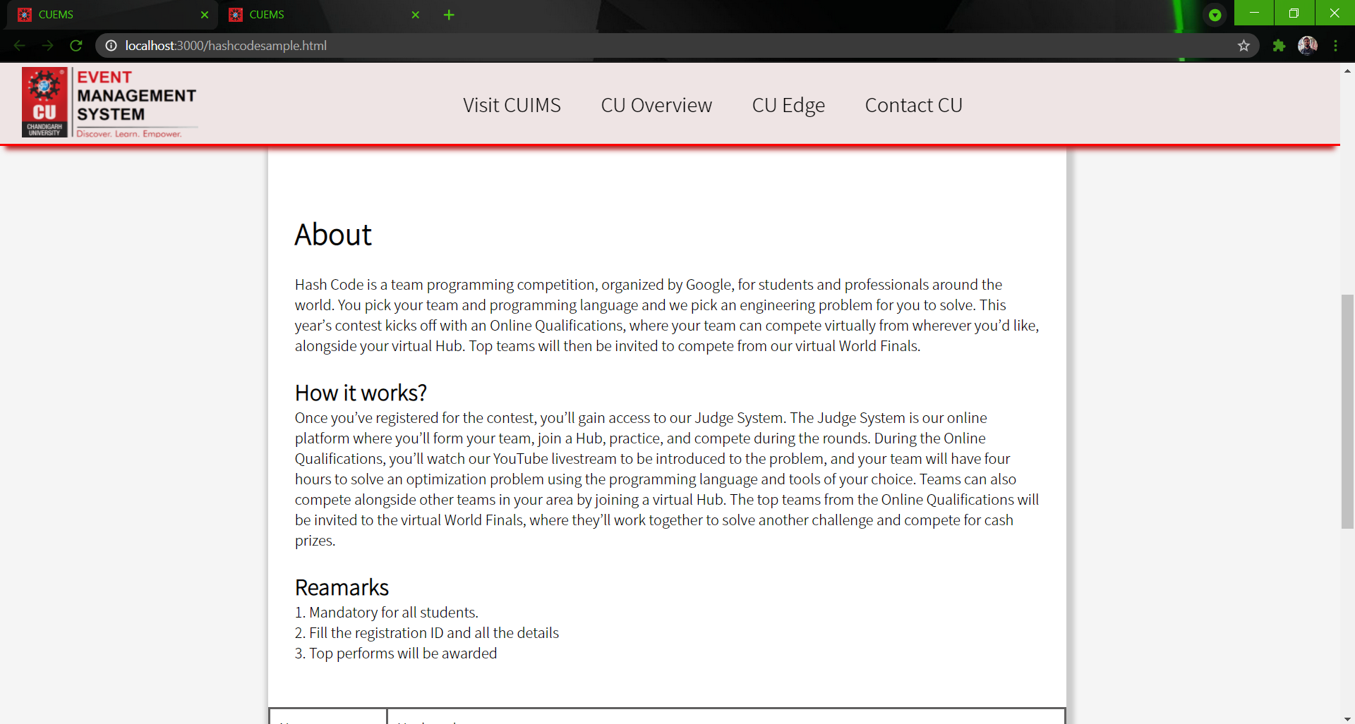
Implementation
Sample Event page :

Slide 19
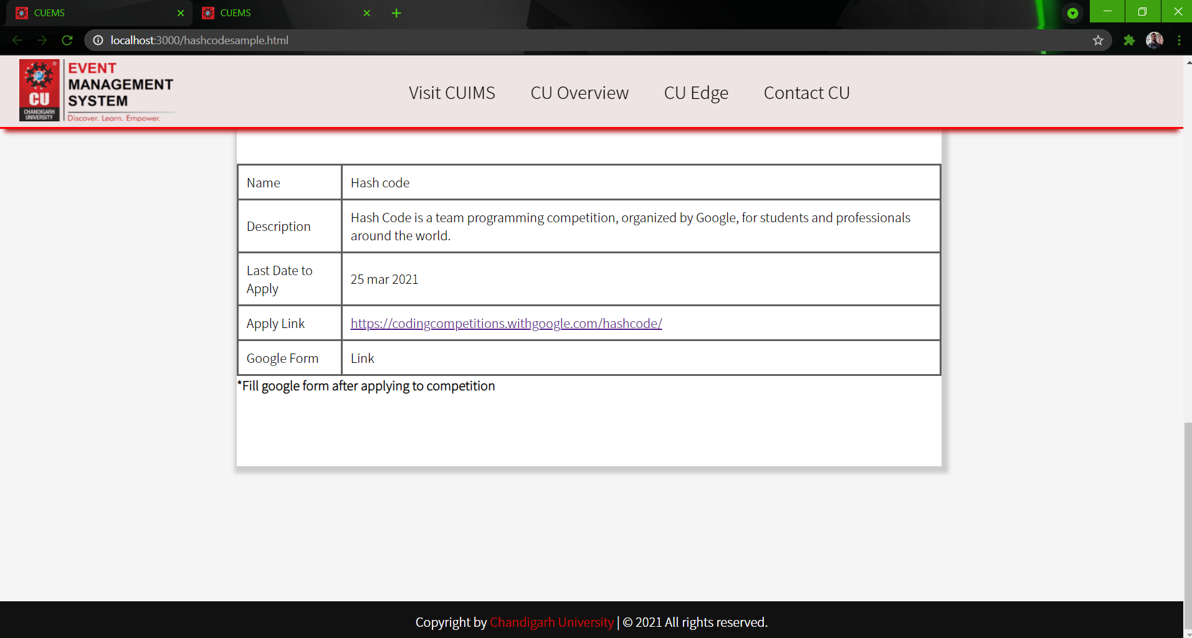
Implementation
Sample Event page :

Slide 20
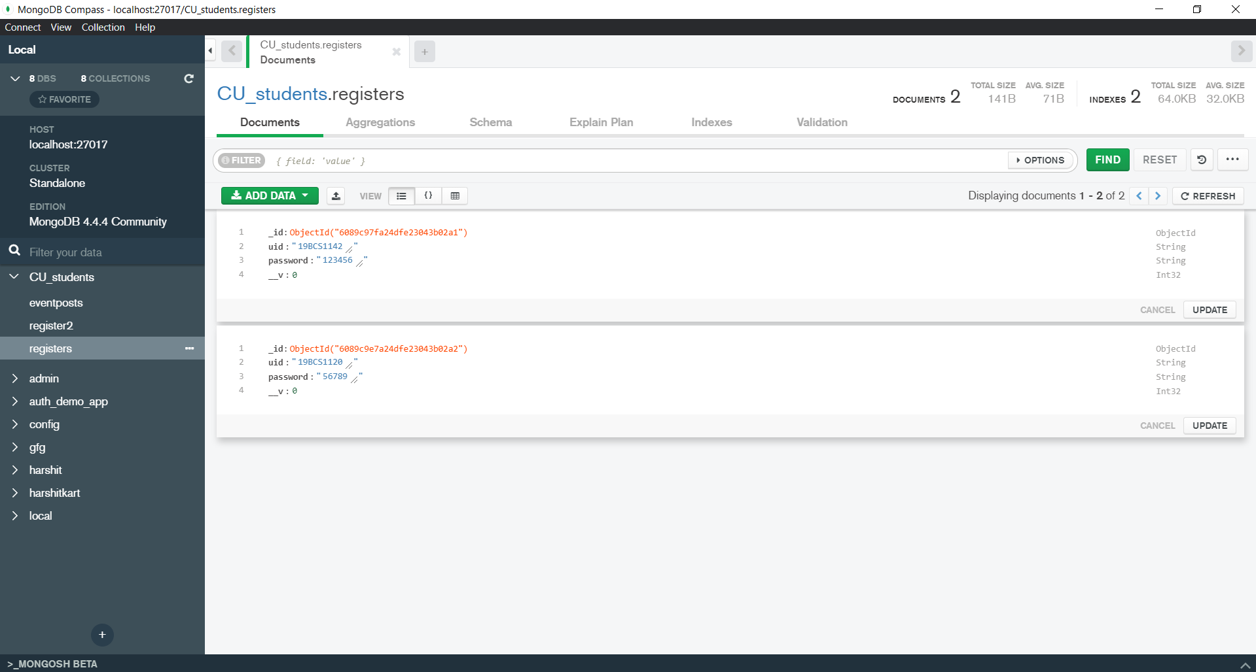
Output validation and comparison
Student Login page validation with backend
Student’s sample database of login credentials

Slide 21
Output validation and comparison
Student Login page validation with backend
Validation/Verification of the student’s login credentials :
app.post("/login", async (req,res) => {
try {
const uid = req.body.uid;
const password = req.body.password;
const studentuid = await Register.findOne({uid:uid});
if(studentuid.password === password){
res.status(201).render("index2");
}else{
res.send("Invalid password");
}
} catch (error) {
res.status(400).send("Invalid UID");
}
});

Slide 22
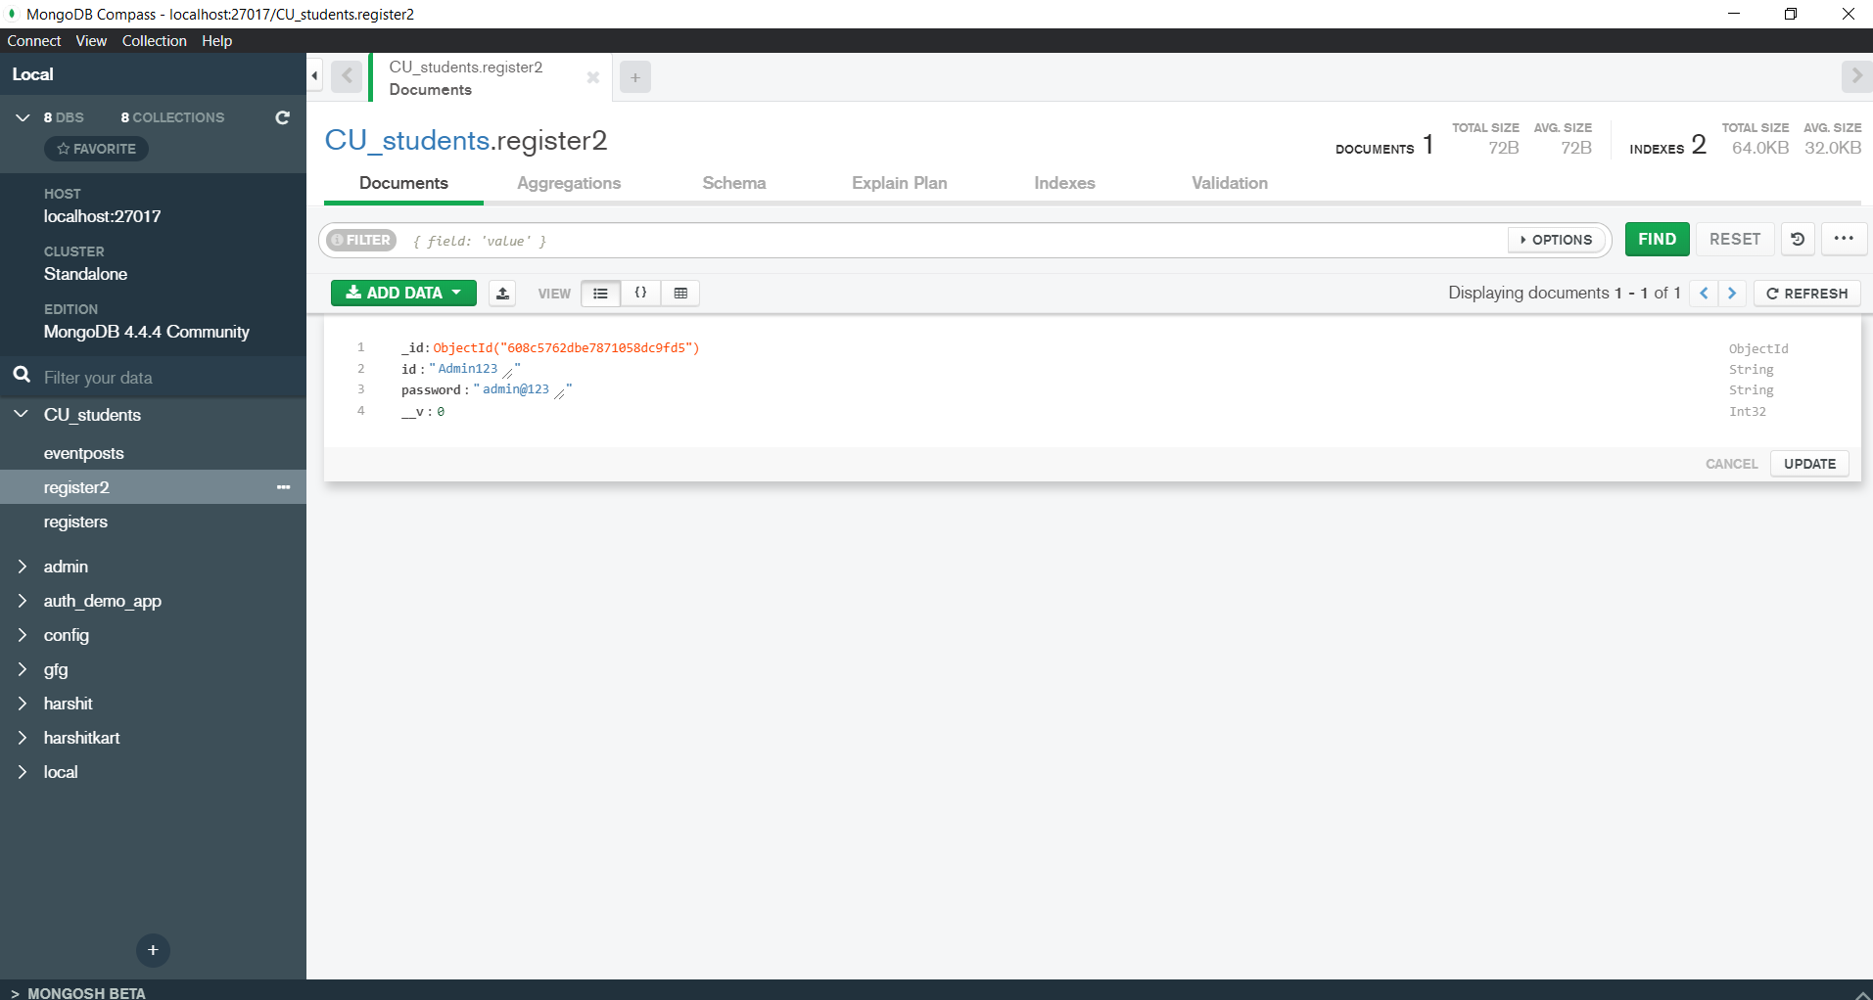
Output validation and comparison
Admin Login page validation with backend
Admin’s sample database of login credentials

Slide 23
Output validation and comparison
Student Login page validation with backend
Validation/Verification of the admin’s login credentials :
app.post("/login2", async (req,res) => {
try {
const id = req.body.id;
const password = req.body.password;
const adminid = await Register2.findOne({id:id});
if(adminid.password === password){
res.status(201).render("index3");
}else{
res.send("Invalid password");
}
} catch (error) {
res.status(400).send("Invalid ID");
}
});

Slide 24
Output validation and comparison
Validation with backend for posting a new Event :
Validation of the event form:
app.post("/eventpost", async (req,res) => {
try {
const registerevent = new eventpost({
myName : req.body.myName,
myEvent : req.body.myEvent,
eventType :req.body.eventType,
myRemark :req.body.myRemark,
myDate :req.body.myDate,
appt :req.body.appt,
myDate1 :req.body.myDate1,
appt1 :req.body.appt1,
myLink :req.body.myLink,
myLink1 :req.body.myLink1,
img :req.body.img
})
const registeredevent = await registerevent.save();
res.status(201).render("index3");
} catch (error) {
res.status(400).send(error);
}
});

Slide 25
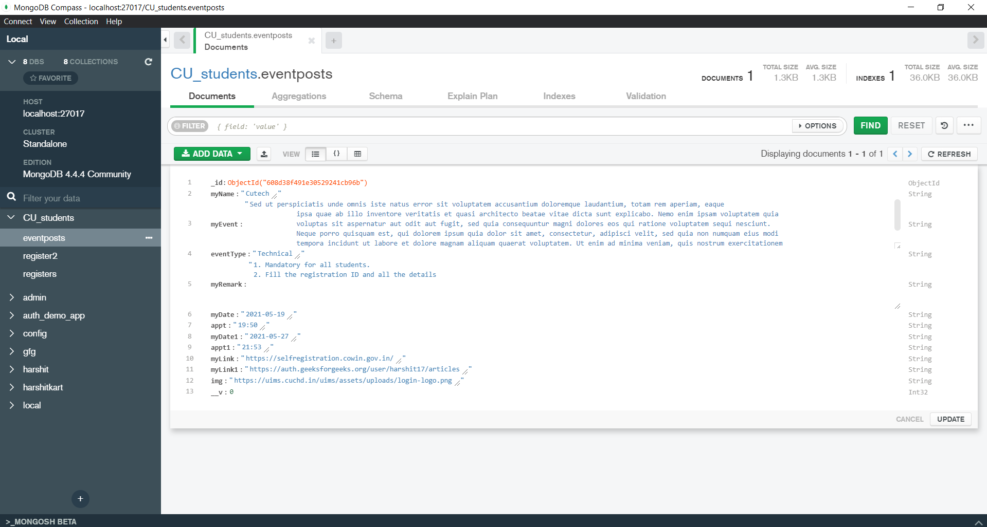
Output validation and comparison
Validation with backend for posting a new Event :
Verification and saving the data of the event form :

Slide 26
Team Work
Name | UID | Class/Sec | Tasks Done
Harshit Srivastava | 19BCS1142 | CSE 2A | Planning, designing and implementation of validation and verification part of the project Front End part using HTML, CSS, JS and Bootstrap. Backend part of the website using Nodejs, Nodemon, Express, Mongoose and MongoDB Documentation
Tanmay Tripathi | 19BCS1120 | CSE 1C | Planning, designing and leading project to end. Designing and development of the front end pages using HTML, CSS, and JS Worked on things like tags, keywords, logo and timers using complex JS libraries. Documentation

